Slide 1
ACTIVITY CLASH
ACTIVITY CLASH

Slide 2
INDEX
Introduction
Project Profile
  Scope of the system
  Modules & Users
  Tools & Technology
Analysis
  Need for the System
  System Flow Diagram
  UML Diagrams
Data Dictionary
Design
  Data Entry Screens (Samples)
  Reports (Samples)
  Test Plan & Test Cases
Future Work
Bibliography
ACTIVITY CLASH

Slide 3
Introduction
  PROBLEM STATEMENT:
The main problem with event marketing is the fact that not all the people get knowledge about the particular events. Many of times, people wish to participate in many events, but cannot because of either lack of knowledge of the particular events, or late registration. This makes them miss out on events they could have participated into.

Slide 4
Introduction
Another common issue with existing web applications or websites for e-marketing is the fact that the user interface is not clean and organized. This means that the participants and the users have to scroll through all events that do not matter to them, just to find those events that do. Hence, this makes the task very cumbersome.
The biggest problem that organizers face is the fact that advertising and marketing events is very costly, and not

Slide 5
Introduction
a lot of people become aware of the fact that the events are occurring. This makes their task full of strife, and yet does not provide a wide reach for the events.
  MOTIVATION:
Due to issues such as lack of awareness and reach of events, and the cumbersome process of registering in events, we have decided to create a web application that can solve all these issues under one web application.

Slide 6
Introduction
Here, the organizers can easily approach us to market their events, and they can be ensured that all the participants registered on our web application can get information about what events are occurring. This means the organizers get a much wider reach.
The benefits of the users and participants is the fact that they can get easy registration on our web application, and also get many financial benefits. Also, this means that the

Slide 7
Introduction
participants can select the events they want to participate in under one web application. Hence, the participants do not have to roam around for event participation.
OBJECTIVES:
Create a dynamic web application.
A web application which provides clean,

Slide 8
Introduction
minimalist user interface. Provides e-marketing and e-advertising for organizers.
Provides categorized events for users. Provides financial benefits to the users.
Enables the user to get e-notification through E-Mails.

Slide 9
Project Profile
Scope of The System
Organizers are provided with e-marketing services. Users can apply for online registration.
All users can get their history and reports.
Participants who have registered through our web application get financial benefits. All users/participants get notifications through E-Mails.
In case or occurrence of future expansion, our web application requires only new changes,
ACTIVITY CLASH

Slide 10
Project Profile
without tampering with the crux of the web
application.
Dynamic/Responsive web application approach.
ACTIVITY CLASH

Slide 11
Project Profile
Modules
  Register
  Login
  Events
  Manage User, Report
  Email
Users
  Admin
  Participant
  Organizer
ACTIVITY CLASH

Slide 12
Project Profile
Tools & Technology
WAMP (Windows Apache MySQL) server
WAMP is a variation of LAMP or Windows systems and is often installed as a software bundle (Apache, MySQL, and PHP). It is often used for web development and internal testing, but may also be used to serve live websites.
The most important part of the WAMP package is Apache (or "Apache HTTP Server") which is used run the web
ACTIVITY CLASH

Slide 13
Project Profile
server within Windows. By running a local Apache web server on a Windows machine, a web developer can test webpages in a web browser without publishing them live on the Internet.
WAMP also includes MySQL and PHP, which are two of the most common technologies used for creating dynamic websites. MySQL is a high-speed database, while PHP is a scripting language that can be used to access data from the database. By installing these two components locally,
ACTIVITY CLASH

Slide 14
Project Profile
a developer can build and test a dynamic website before publishing it to a public web server. While Apache, MySQL, and PHP are open source components that can be installed individually, they are usually installed together. One popular package is called "WampServer", which provides a user-friendly way to install and configure the "AMP" components on Windows.
ACTIVITY CLASH

Slide 15
Project Profile
PHP
Stands for "Hypertext Preprocessor." (It is a recursive acronym, if you can understand what that means.) PHP is an HTML-embedded Web scripting language. This means PHP code can be inserted into the HTML of a Web page. When a PHP page is accessed, the PHP code is read or "parsed" by the server the page resides on. The output from the PHP functions on the page are typically returned as HTML code, which can be read by the browser. Because the PHP code is transformed into HTML before the page is
ACTIVITY CLASH

Slide 16
Project Profile
loaded, users cannot view the PHP code on a page. This make PHP pages secure enough to access databases and other secure information.
A lot of the syntax of PHP is borrowed from other languages such as C, Java and Perl. However, PHP has a number of unique features and specific functions as well. The goal of the language is to allow Web developers to write dynamically generated pages quickly and easily. PHP is also great for creating database-driven Web sites.
PROJECT NAME

Slide 17
Project Profile
The best things in using PHP are that it is extremely simple for a newcomer, but offers many advanced features for a professional programmer. Don't be afraid reading the long list of PHP's features. You can jump in, in a short time, and start writing simple scripts in a few hours.
Features of PHP:
    Simple
    Faster
    Interpreted
    Open Source
ACTIVITY CLASH

Slide 18
Project Profile
    Case Sensitive
    Simplicity
    Efficiency
    Platform Independent
    Security
    Flexibility
    Familiarity
    Error Reporting
    Loosely Typed Language
    Real-Time Access Monitoring
ACTIVITY CLASH

Slide 19
Project Profile
Simple
It is very simple and easy to use, compare to other scripting language it is very simple and easy, this is widely used all over the world.
Interpreted
It is an interpreted language, i.e. there is no need for compilation.
Faster
It is faster than other scripting language e.g. asp and jsp.
Open Source
Open source means you no need to pay for use php, you can free download and use.
ACTIVITY CLASH

Slide 20
Project Profile
Features of MySQL:
Relational Database System: Like almost all other database systems on the market, MySQL is a relational database system.
Client/Server Architecture: MySQL is a client/server system. There is a database server (MySQL) and arbitrarily many clients (application programs), which communicate with the server; that is, they query data, save changes, etc. The clients can run on the same
ACTIVITY CLASH

Slide 21
Project Profile
computer as the server or on another computer (communication via a local network or the Internet).
SQL compatibility: MySQL supports as its database language -- as its name suggests – SQL (Structured Query Language). SQL is a standardized language for querying and updating data and for the administration of a database.
User interface: There are a number of convenient user interfaces for administering a MySQL server.
ACTIVITY CLASH

Slide 22
Analysis
Need for the system [ basic requirement ]
  HARDWARE REQUIREMENTS:
    Processor: Intel CORE i3
    RAM: 1 GB
    Hard Disk Drive: 80 GB
  SOFTWARE REQUIREMENTS:
    Internet Explorer, Google Chrome, Mozilla Firefox
    Operating System: Windows 7
    WAMP (Windows Apache MySQL PHP) server
ACTIVITY CLASH

Slide 23
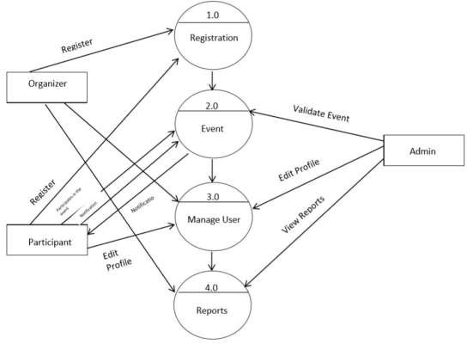
Analysis
System flow diagram
ACTIVITY CLASH

Slide 24
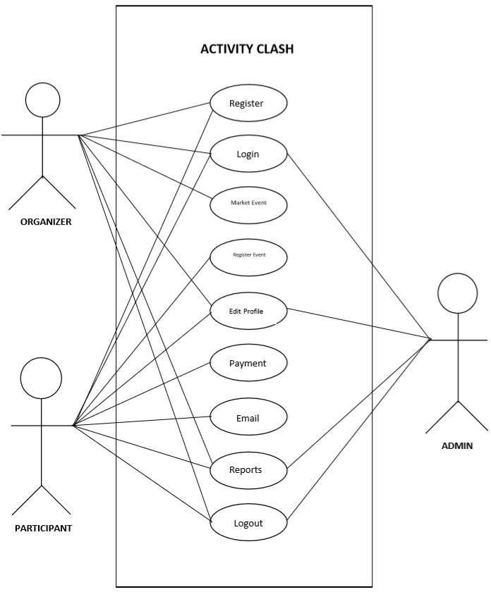
UML Diagrams
Use Case Diagrams
ACTIVITY CLASH

Slide 25
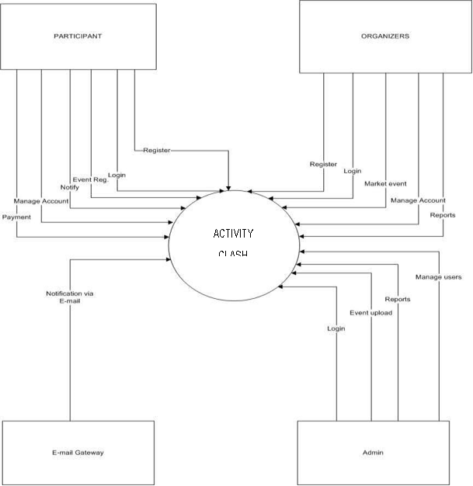
UML Diagrams
Activity Diagrams
ACTIVITY CLASH

Slide 26
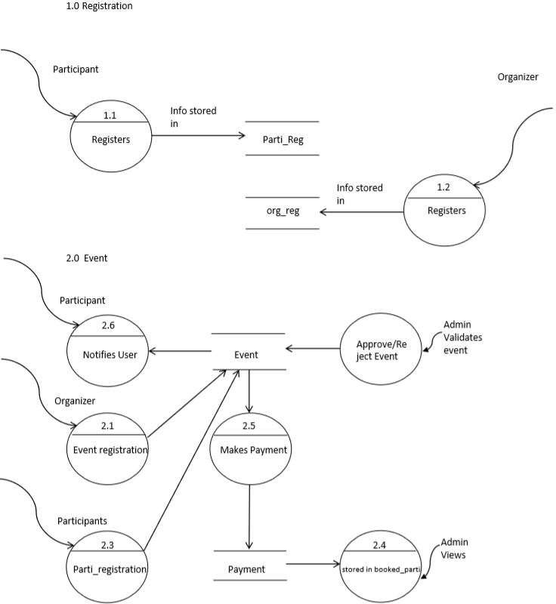
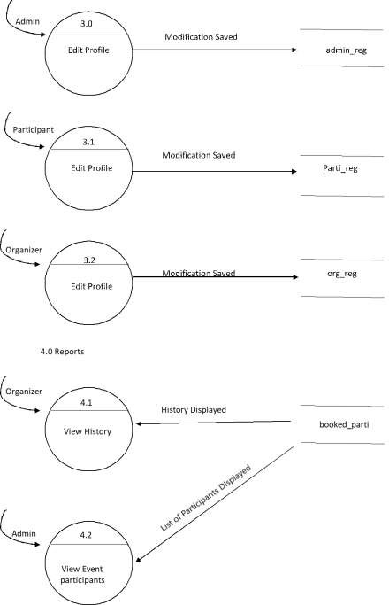
UML Diagrams
Sequence Diagram
        3.0 Manage Account
ACTIVITY CLASH

Slide 27
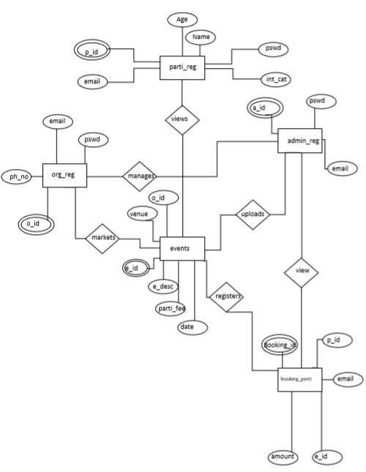
UML Diagrams
E-R Diagram
ACTIVITY CLASH

Slide 28
Data Dictionary
Table Name: admin_reg
Description: This table contains the admins information.
Sr. No | Fieldname | Datatype | Size | Constraint | Description
1 | a_id | Int | 20 | primary key | admin’s user id
2 | email | varchar | 35 |  | email of admin
3 | pswd | varchar | 8 |  | password of admin
4 | name | varchar | 20 |  | admin’s name

Slide 29
Data Dictionary
Table Name: org_reg
Description: This table contains the organizers information.
Sr. No | Fieldname | Datatype | Size | Constraint | Description
1 | o_id | int | 5 | Primary key | Organizer’s user id
2 | email | varchar | 35 |  | Email of the organizer
3 | pswd | varchar | 16 |  | Password of the organizer
4 | p_no | bigint | 12 |  | Phone number of the organizer
5 | name | text | 20 |  | Name of the organizer

Slide 30
Data Dictionary
Table Name: parti_reg
Description: This table contains the participants information.
Sr. No | Fieldname | Datatype | Size | Constraint | Description
1 | p_id | int | 20 | Primary key | Participant’s user id
2 | email | varchar | 35 |  | Email of the participant
3 | pswd | varchar | 16 |  | Password of the participant
4 | int_cat | varchar | 15 |  | Selected interested categories of participants
5 | age | int | 3 |  | Age of the participants
6 | name | text | 20 |  | Name of the participants

Slide 31
Data Dictionary
Table Name: event
Description: This table contains the event information.
Sr. No | Fieldname | Datatype | Size | Constraint | Description
1 | e_id | int | 11 | Primary key | Event id
2 | o_id | varchar | 5 | Foreign key | Organizer’s ID
3 | e_name | text | 20 |  | Name of the event
4 | venue | varchar | 11 |  | Venue of the event
5 | date | date | 20 |  | Date and time of the event
6 | parti_fee | int | 11 |  | Registration fee
7 | e_desc | varchar | 50 |  | Description of the event
8 | cat | varchar | 15 |  | Category of any particular event
9 | max_parti | int | 11 |  | Maximum number of the participants
10 | validate | int | 1 |  | Flag variable for admin’s validation
11 | e_img | varchar | 70 |  | Path of the event’s image

Slide 32
Data Dictionary
Table Name: booked_parti
Description: This table contains the information about the participants who have booked particular events.
Sr. No | Fieldname | Datatype | Size | Constraint | Description
1 | p_id | int | 20 | Foreign Key | Participant’s Id
2 | e_id | int | 20 | Foreign Key | Event ID
3 | booking_id | int | 5 | Primary Key | Booking ID of the participant
4 | email | varchar | 35 |  | Email of the participant
5 | account | int | 5 |  | Amount of registration

Slide 33
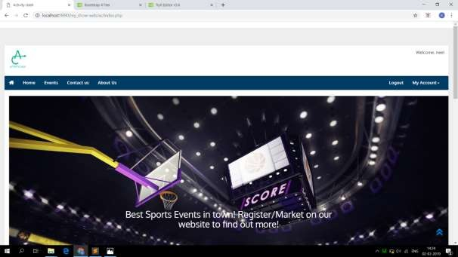
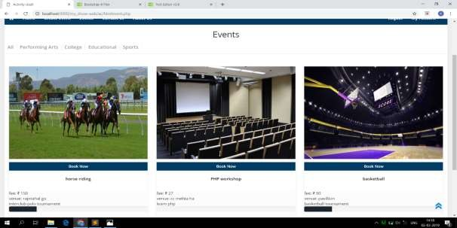
Design
Description: This page contains the homepage of the website & the event ordered by categories.

Slide 34
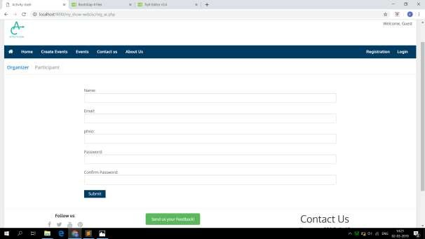
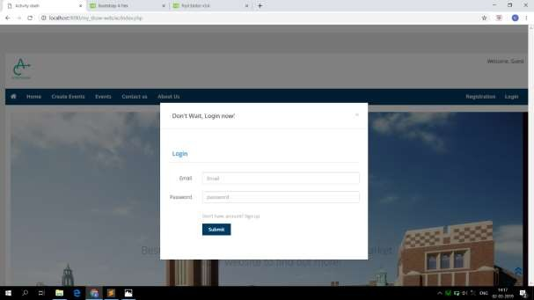
Design
Description: This the page contains the registration form & the login page of the website.

Slide 35
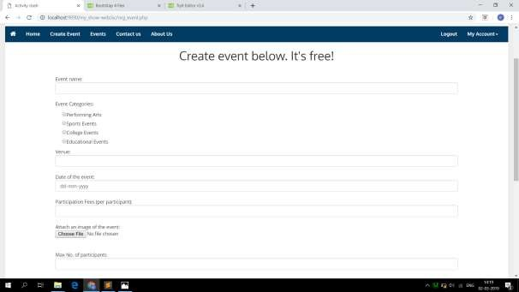
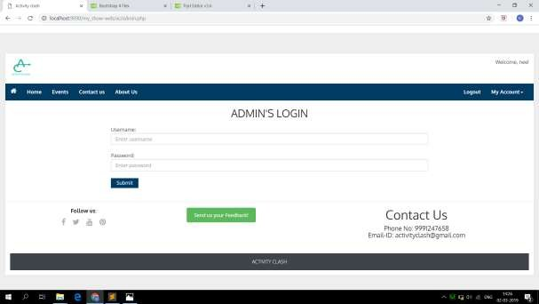
Design
Description: This the page contains the create event page of the website & admin Login.

Slide 36
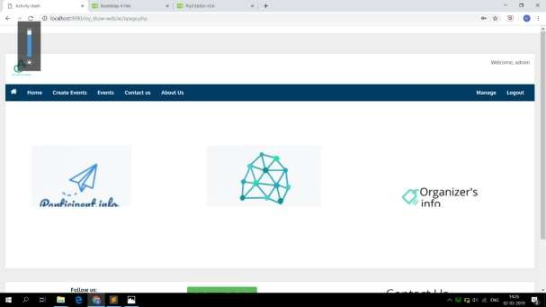
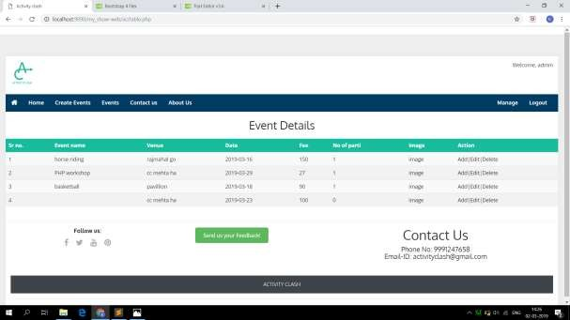
Design
This the page contains the reports page of the website & event details.

Slide 37
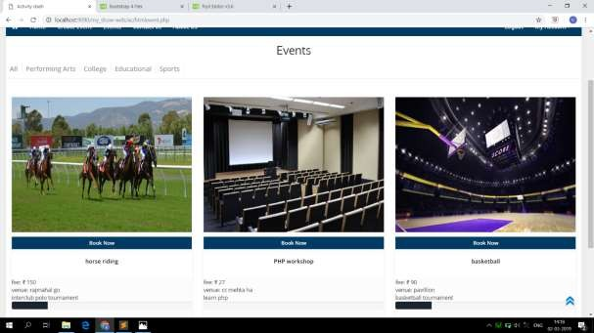
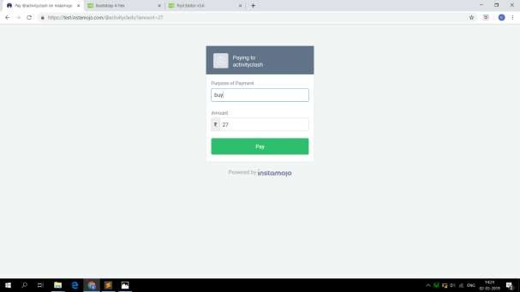
Design
This the page contains the uploaded events of the website & payment of an event.

Slide 38
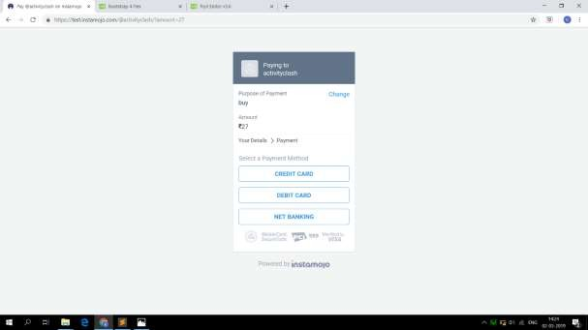
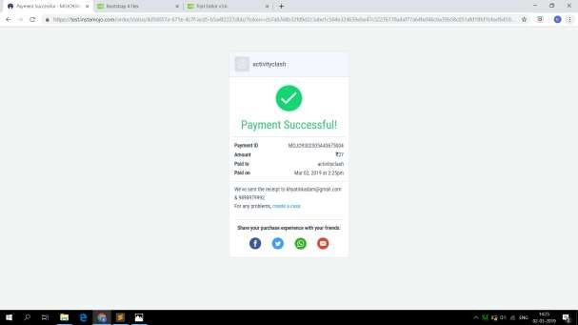
Design
Description: This the page contains the payment process page of the website.

Slide 39
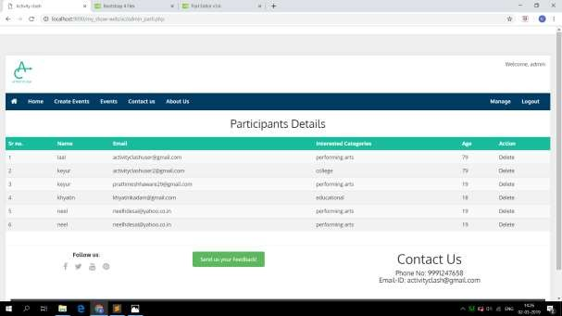
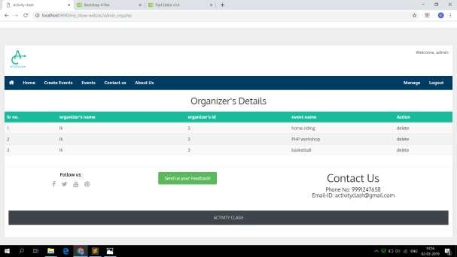
Design
Description: This the page contains the participants & organisers details page of the website.

Slide 40
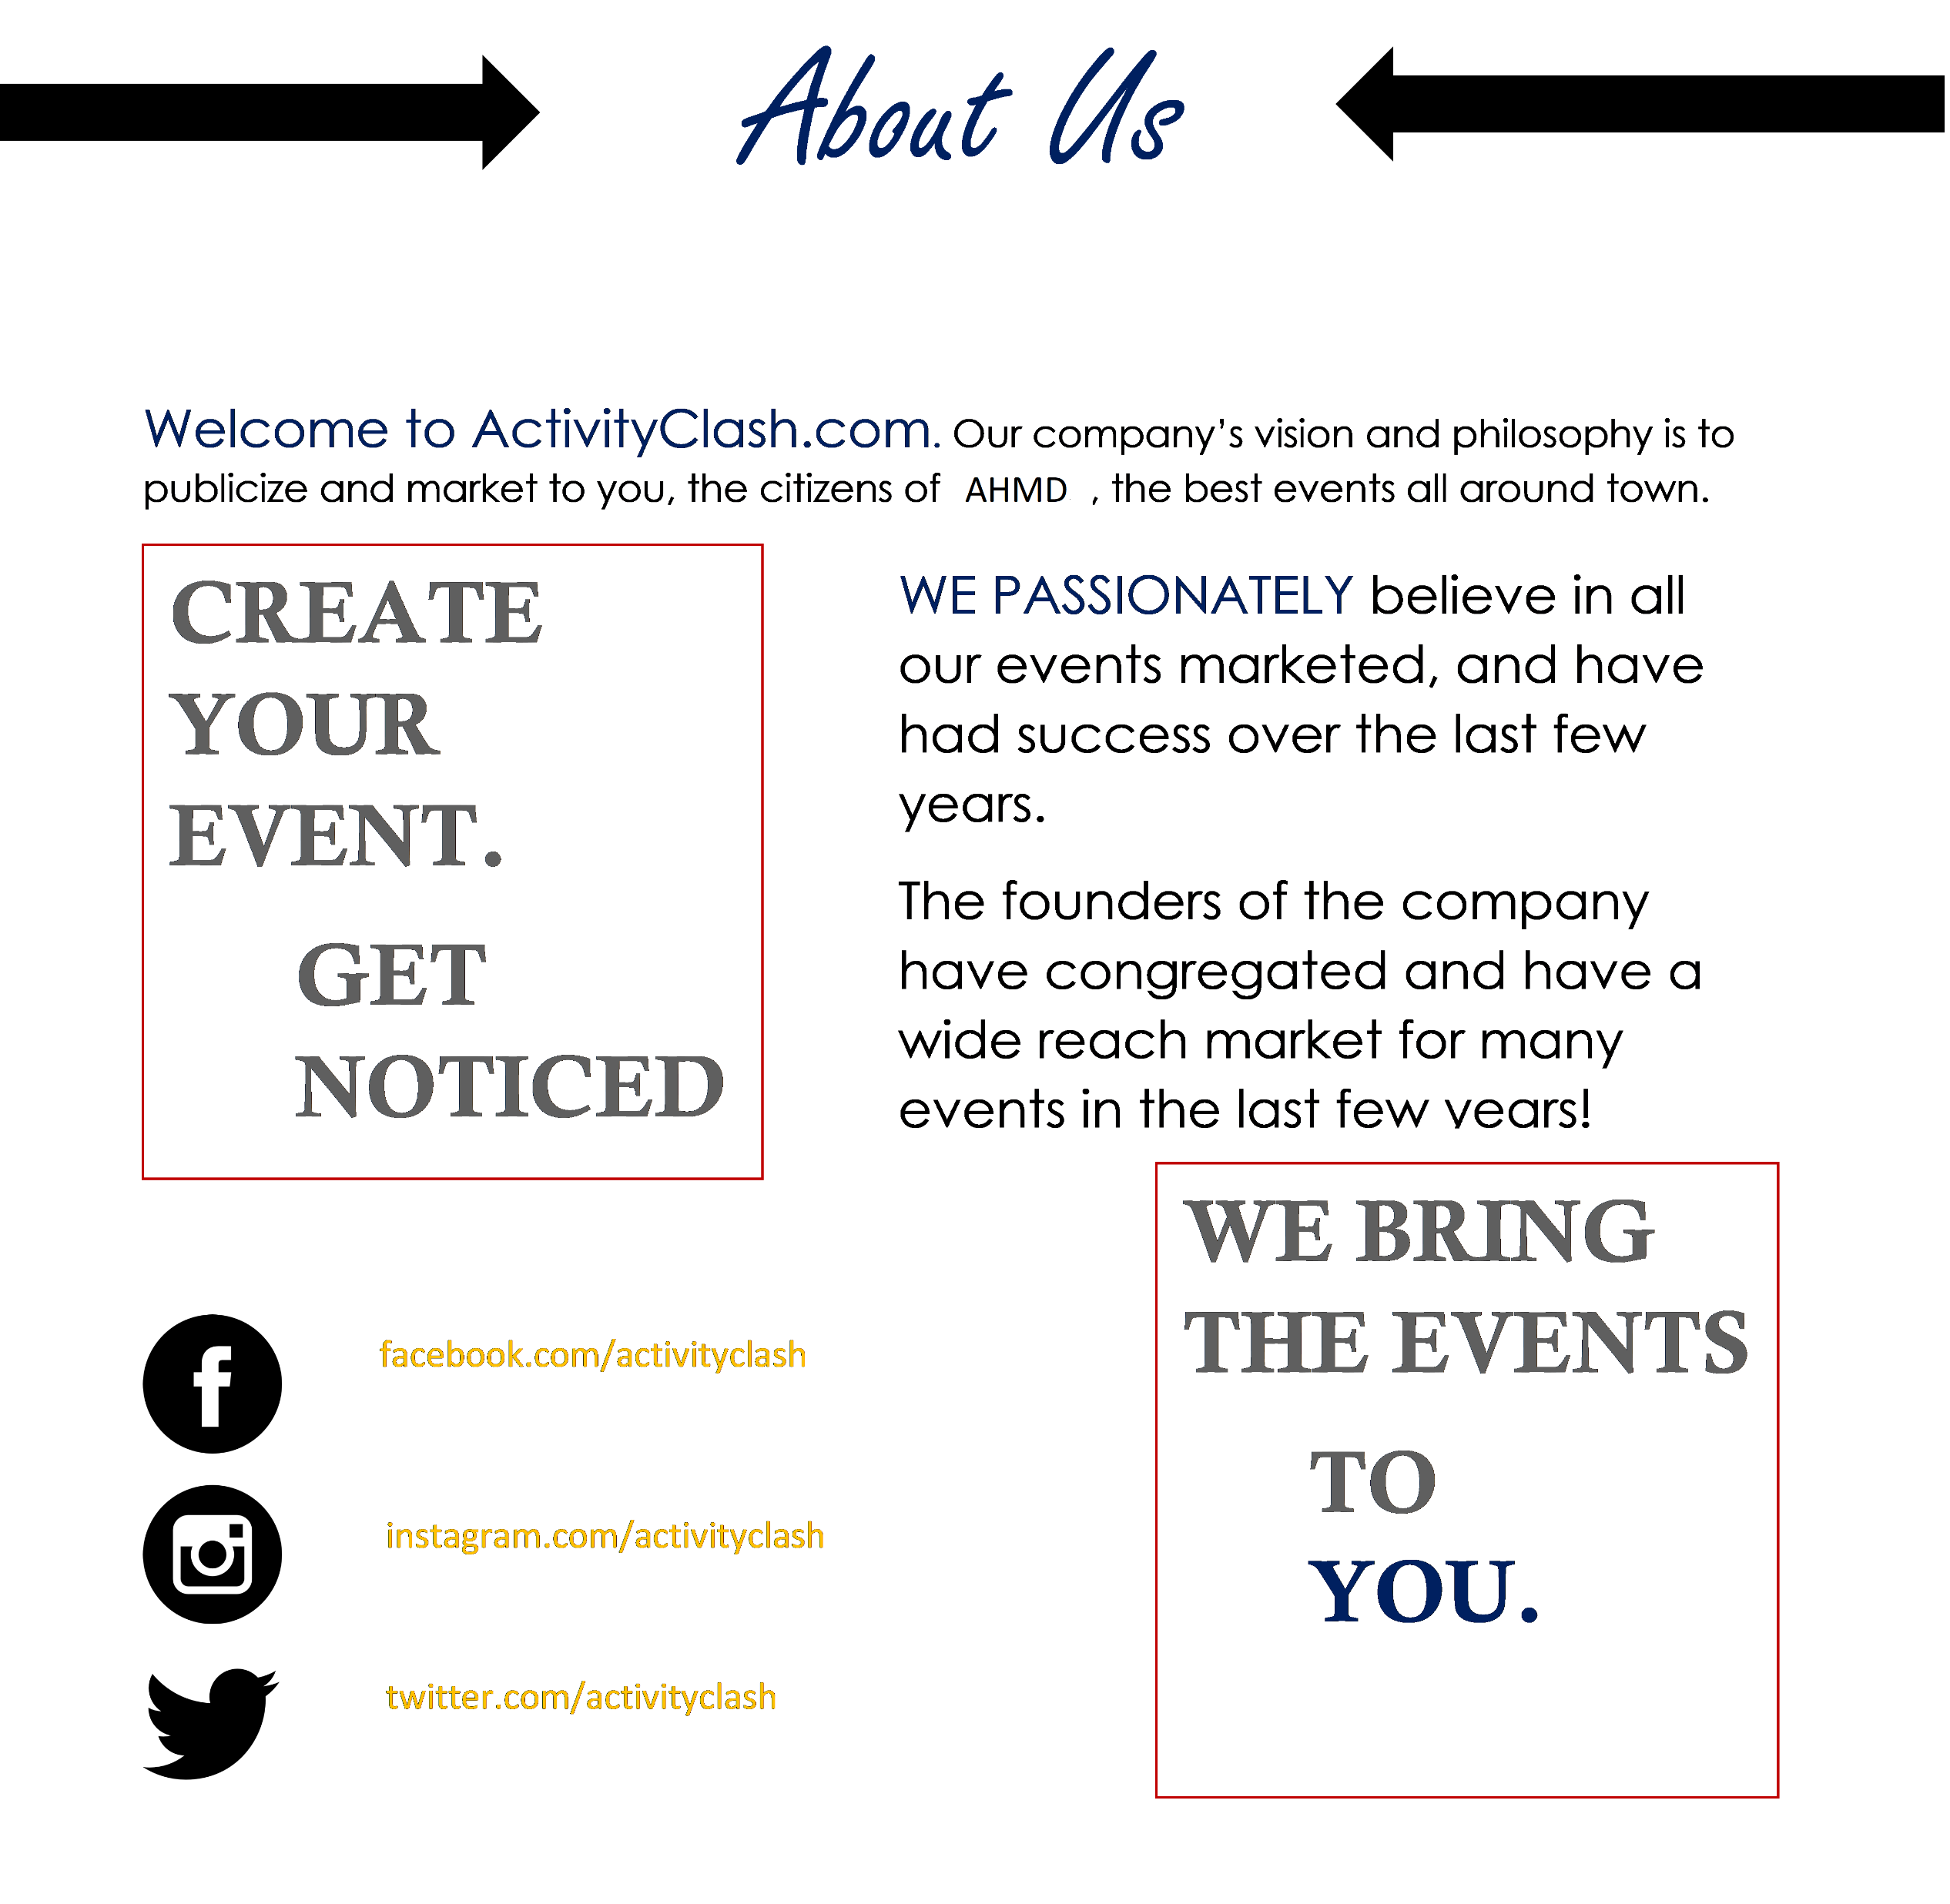
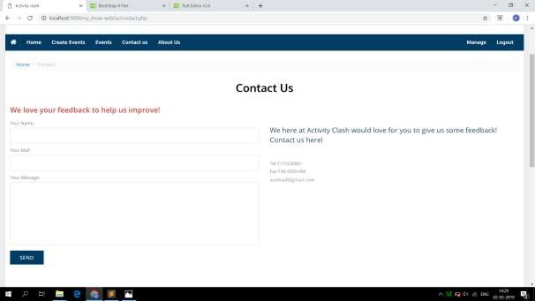
Design
Description: This the page contains the contact us & about us page of the website.

Slide 41
Test Plan & Test Cases
Testing Plan:
Test strategy is the set of guidelines that explains test design and determines how the testing needs to be done. It is carried out by the system, the test was observed that this configuration does not cause any improper violation. It depends upon the number of facts like the number of input parameter and argument attributes. A software testing technique whereby explicit knowledge of internal workings of the item being testing are used to select data. This test is accurate only if tester knows what the program is actually to do so that for particular input a particular output is obtained.

Slide 42
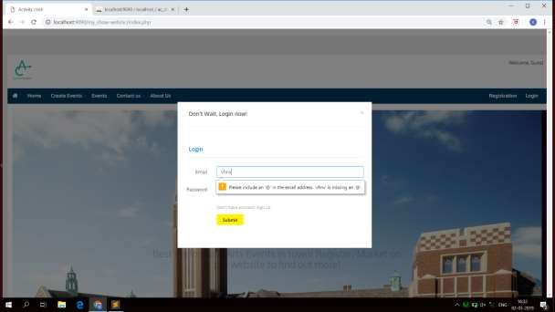
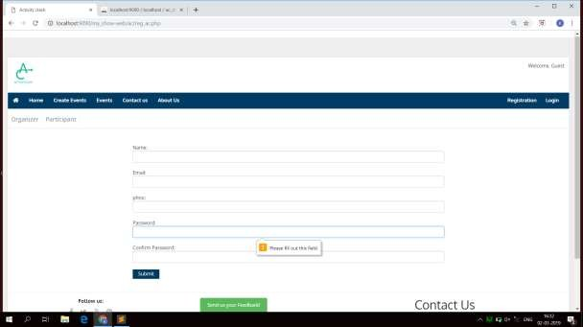
Test Plan & Test Cases
Description: This the page contains the testing of the login & register page.

Slide 43
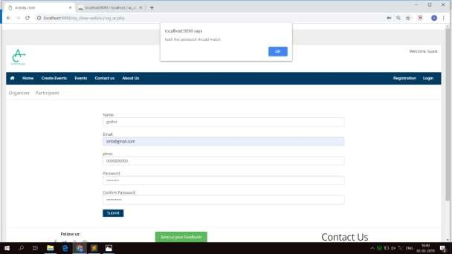
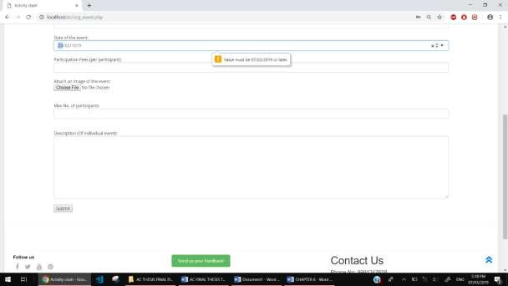
Test Plan & Test Cases
Description: This the page contains the testing of the Date Validation & register page.

Slide 44
Future Work
We have many plans for the upcoming future of our website. Since our website currently only bounded to a city, we are planning to expand our reach to states. This will allow our website more reach, more insights, and also will help the people across the country to have a single website to rely on. Hence, our future plans include:
More wider reach
Expand business
More event categories
Collaboration with MNC’s

Slide 45
Bibliography
Book’s references:
Programming PHP – Rasmus Lerdorf
Mastering HTML,CSS And JavaScript – Lemay Laura
Online references:
Bootstrap: Understanding bootstrap with the help of the intellectual website i.e - w3school
https://www.w3schools.com/bootstrap/
PHP: Understanding PHP with the help of the intellectual website i.e - w3school
https://www.w3schools.com/php/default.asp
HTML/CSS: Understanding HTML/CSS with the help of the cognitive website i.e stackoverflow
https://stackoverflow.com/questions/45254976/how-to-learn-html-and-css

Slide 46
Thank You

